Slide 1

Plant Breeding Journal and R Club
November 6th
1:00-3:00 pm
Johnson Hall 204

Slide 2
1st Meeting: November 6th, 2019
Introduction of the Club
Monthly Schedule
GitHub
RMarkdown
First of the Month Priorities
Introduce Data Set and Objectives
Introduce Paper
Input
Types of analysis
Topics or Papers to discuss
Help Getting Ready
Set up R or R Markdown
GitHub Account

Slide 3
Monthly Schedule.
1st week: | Introduce data set and objectives for the month Introduce 1-2 journal articles (possibly from TAG collection) -breeder can pick an article or a student can pick the article(s)
2nd week: | Group working session: discuss and work on the data set together -- optional attendance for those wanting to work with others on the project
3rd week: | Group working session: discuss and work on the data set together -- optional attendance for those wanting to work with others on the project
4th week: | Breeder attend meeting. Discuss results of data sets and any other plant breeding questions- Discuss journal article
Notes:
Week 4 is the most important week to attend.
Discuss data and paper.
Probably will go entire two hours.

Slide 4
GitHub: R-Breeding-Group
Project: November 2019
Name of article
Name of data set
Objectives
Repository: November-2019
Description of data set
CSV
Hub For Collaboration
Results
Code
Any Helpful or Relevant Material

Slide 5
GitHub
Repository: Club-Information
R and R Markdown cheat sheets
LaTex and ggplot2 cheatsheets
Helpful Links
Example of R Markdown Code
Helpful Book List
Helpful Books
The R Book
Data Visualization
A Handbook of Statistical Analyses using R
An Introduction to Statistical Learning: with Applications in R
Principles of Cultivar Development
Any Rex Bernardo Book

Slide 6
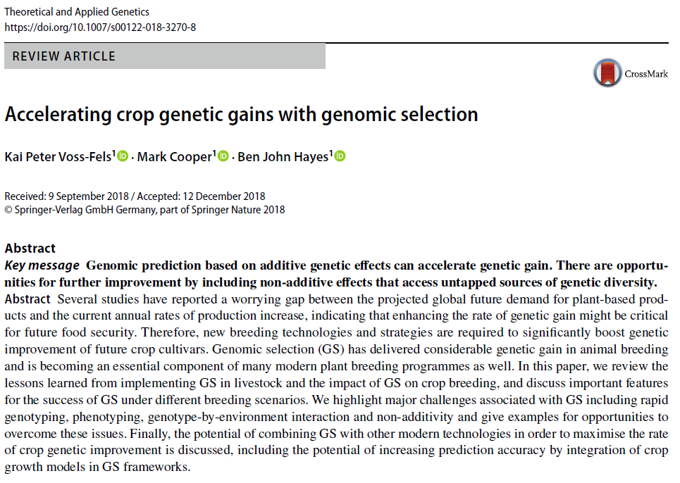
Academic Paper: Accelerating Crop Genetic Gains with Genomic Selection

Slide 7
Data Set: Western Wheat Quality lab data for the Soft Elite nursery entries
35 Variables
258 Observations
Quality data compiled from tests in 2016-2018
Unbalanced
Multiple Locations
Check cultivars are lines with a name
Some outliers removed

Slide 8
Quality Data
Micromill physical traits - used in early generations
Solvent traits - used in early generations
Kernel traits - used in early generations
Milling traits requires more grain - later generations
Product traits requires grain and time - later generation
Description of Data
Lower, Neutral, Higher
Line and trial information
Selection Year

Slide 9
Objectives: To what extent can we use early generation traits to predict the Milling and product traits?
What are the correlations among the traits?
What are the heritabilities?
How does the variation due to environment differ among the traits?
Are there any pedigrees that perform particularly well or particularly bad? Any clusters?
What should I select?
Questions:
A good club wheat has high cake volume, low gluten strength, high test weight, high break flour and high flour yield.
Can you make any suggestions for crosses that I might want to make?
Stakeholders have asked to increase kernel size and test weight and reduce LDOPA as well.

Slide 10
Results, Visualization, and Exploration
Write a Report
R-Markdown
Data Exploration
Data Visualization
Data Analysis and Interpretation
How to properly display data
Tables?
Graphs?

Slide 11
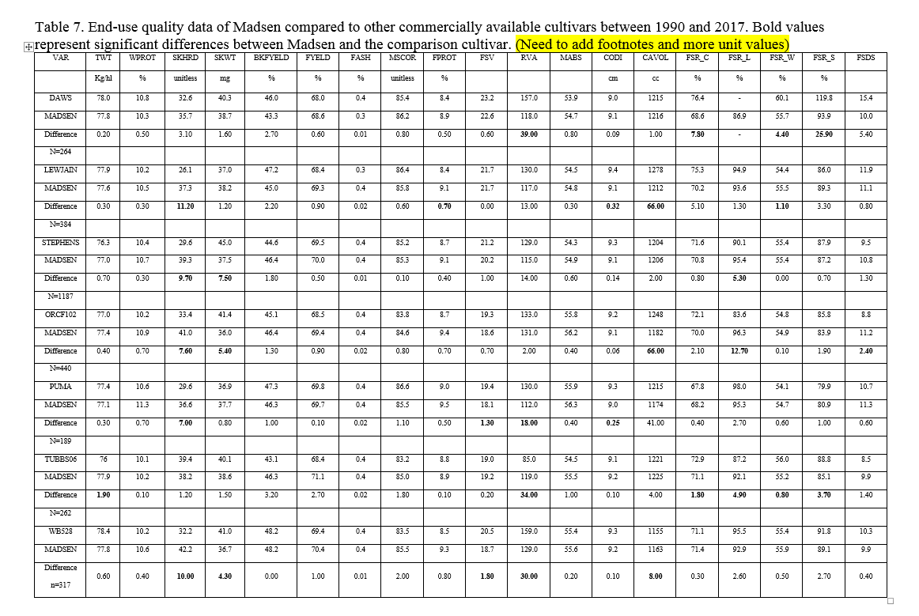
Extra Objective: How to better visualize results

Slide 12
Input from You
Certain papers?
Analyses?
Notes:
This is a group by students, for students
Facilitate learning
Any books, code, or anything else

Slide 13
Next Meeting
November 13th
Optional
Group Working Session:
Discuss Data and Analysis

Slide 14
“Civilization as it is known today could not have evolved, nor can it survive, without an adequate food supply”
Norman Borlaug
Notes:
Just a quote I like from the O.G. for a boost of confidence for our fellow plant breeders

